Slide 1
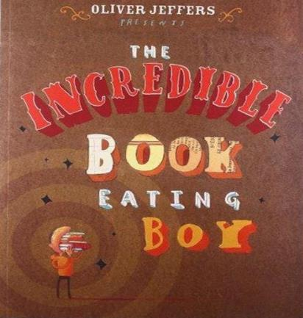
Year 4: Digestive System Knowledge Mat
Subject Specific Vocabulary |  | Interesting Book | Sticky Knowledge about the digestive system
pancreas | The pancreas produces juices called enzymes which helps the body digest food.
 |  |  | The oesophagus is the food highway that takes your dinner from your mouth down into your stomach so that digestion can begin.
oesophagus | The oesophagus is like a stretchy tube that moves food from the back of the throat to the stomach.
intestine | The main function of the small intestine is absorption of nutrients and minerals from food. The major function of the large intestine is to absorb water from the remaining indigestible food. |  | The stomach is filled with powerful acids that break down the food into smaller pieces. It also lets us know when we are hungry.
 |  |  | The liver creates different enzymes to help process food nutrients that are collected in the small intestine.
organ | The skin is the biggest organ of your body. Other organs include your brain, lungs, heart, liver, stomach, intestines, pancreas, and kidneys, and they're called internal organs
 |  |  | The gallbladder is a storage unit for all of the bile and enzymes created by the liver. It stores them until they are needed for digestion.
molars | Molars are the teeth that are used for chewing and grinding our food. |  | Animals like cockroaches are really important in a habitat—they eat the dead plants and recycle the nutrients back into the soil.
 |  | Important facts to know by the end of the digestive system topic:
canine | Canine are the teeth used for ripping and tearing our food. We have two located at the top of our mouth and two and the bottom.
 |  |  | The main job for the small intestine is to absorb nutrients and minerals from food. In fact, 90% of food absorption takes place here, making it our main digestion location.
 |  | Know and name the parts of the digestive system. Know the function of each organ of the digestive system. Know and identify the different types of teeth in humans. Know the function of different human teeth Use food chains to identify producers, predators and prey. Construct food chains to identify producers, predators and prey.
food chain | A food chain is a diagram that shows us how animals are linked by what they eat
 |  |  | The outside of our teeth are covered with enamel and the inside have blood vessels and nerves.
predators | Predators are wild animals that hunt, or prey on, other animals. Predator animals need the flesh of the animals that they kill to survive.
 |  |  | The front teeth are called incisors, the four sharp teeth are called canines, the teeth at the back are called molars.
prey | The term prey refers to an animal that is sought, captured, and eaten by a predator.
salivary gland | The salivary glands contains special enzymes that help digest the starches in your food.

